Slide 1
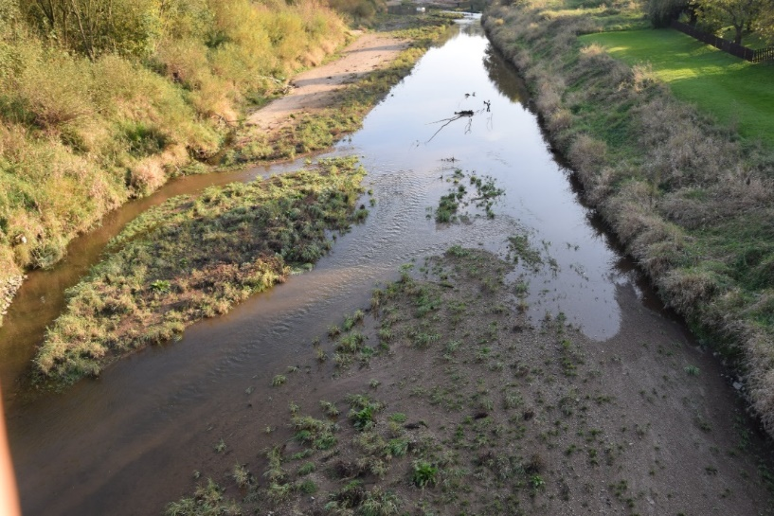

DROUGHT HAZARD ASSESSMENTS AS BASE FOR DROUGHT RISK REDUCTION part 2
Wiwiana SZALIŃSKA, Tamara TOKARCZYK

Slide 2
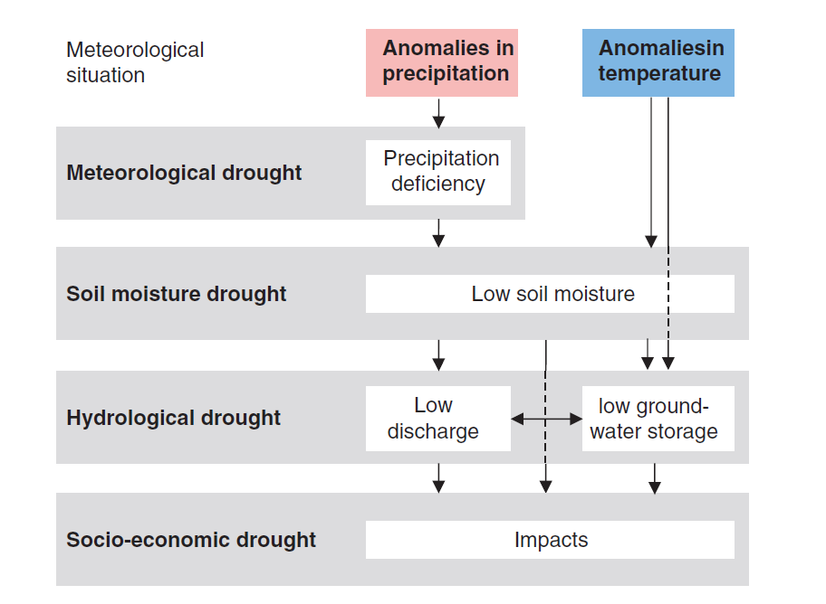
CATEGORIS OF DROUGHT
AGRICULTURAL DROUGHT
Van Loon, 2015, Hydrological drought explained.

Slide 3
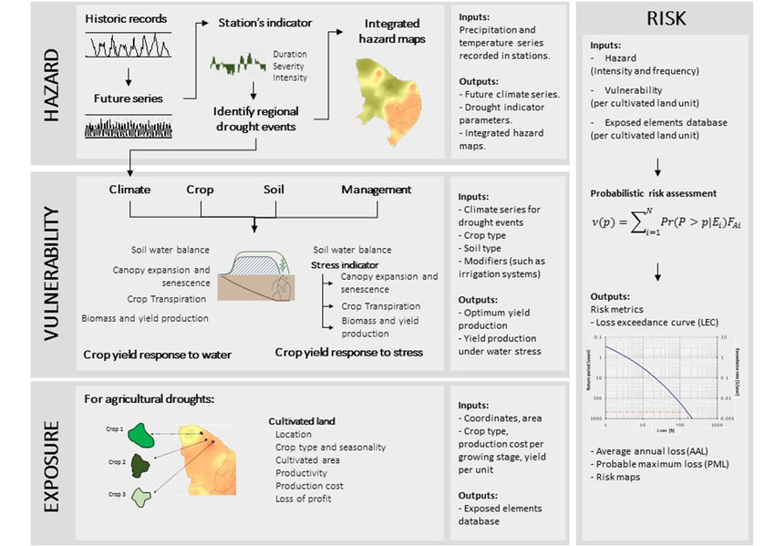
DROUGHT AS RISK

Slide 4
DROUGHT RISK ASSESSMENT
consequences
exposure
Losses in haverst yield
Number of fatalities
Economic impacts
Land use
sown area
Crop structure
No of people exposed
Critical ecosystems
Critical infrastructure
Satellite data (Landsat 8, Sentinel-1, Sentinel-2)
DROUGHT IMPACTS
resilience
Soil moisture index
Actual evapotraspiration index
Distance to road
Distance to river
Water management
Water infrastructure
DROUGHT RISK
voulerability
Drought
hazard
monitoring
sensitivity
HAZARD
Precipitation
Temperature
Air Humidity
Insolation
Wind speed
Water levels
Crop condition
Phenological stage
Vegetation biomass
…
Ground-based monitoring network
Drought indicators
Weather prediction models

Slide 5
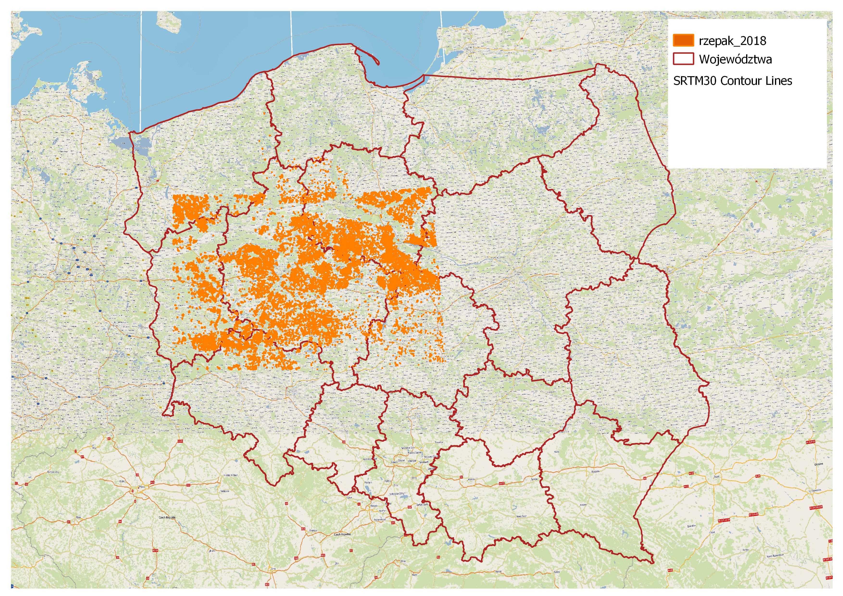
DROUGHT RISK ASSESSMENT
WIELKOPOLSKA PROVINCE

Slide 6
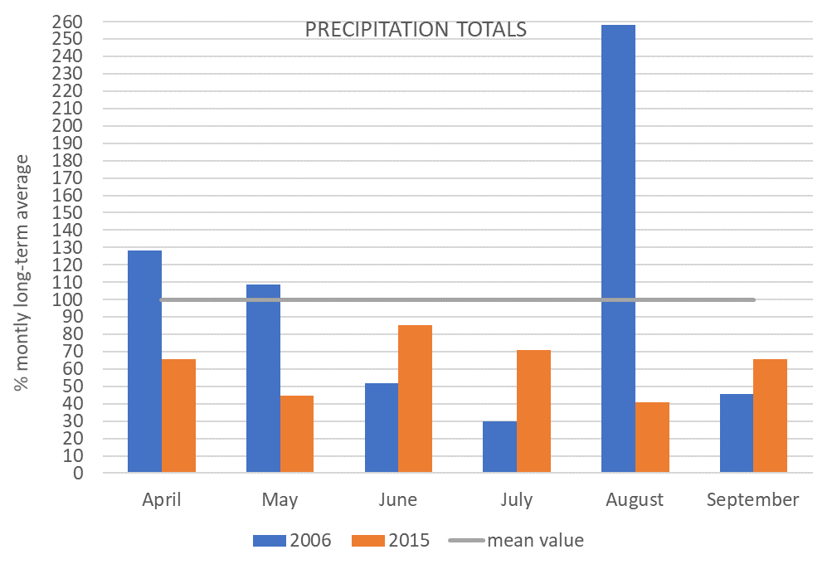
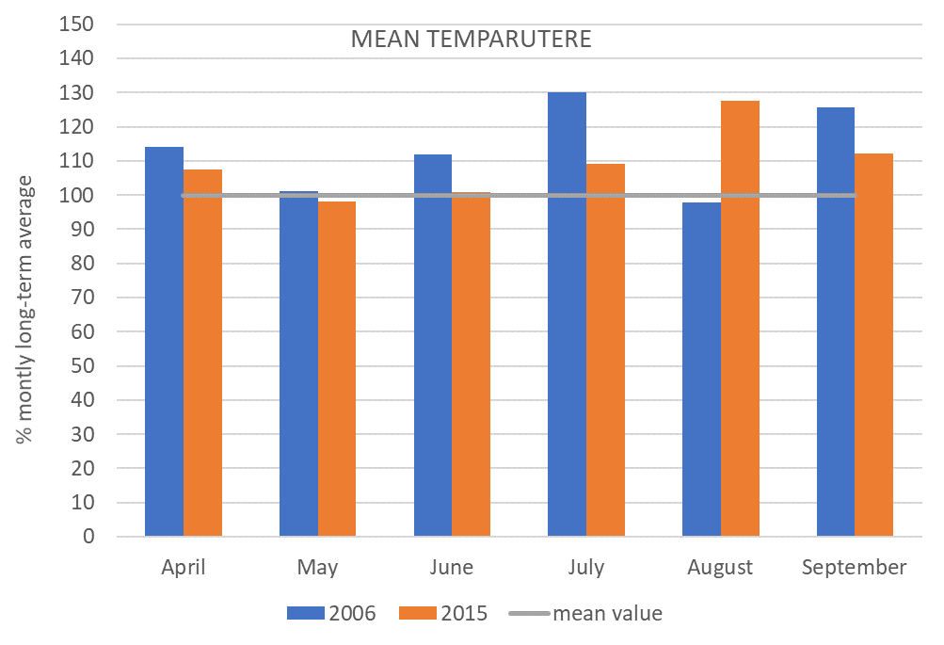
HAZARD INDICES
PRECIPITATION
TEMPERATURE

Slide 7
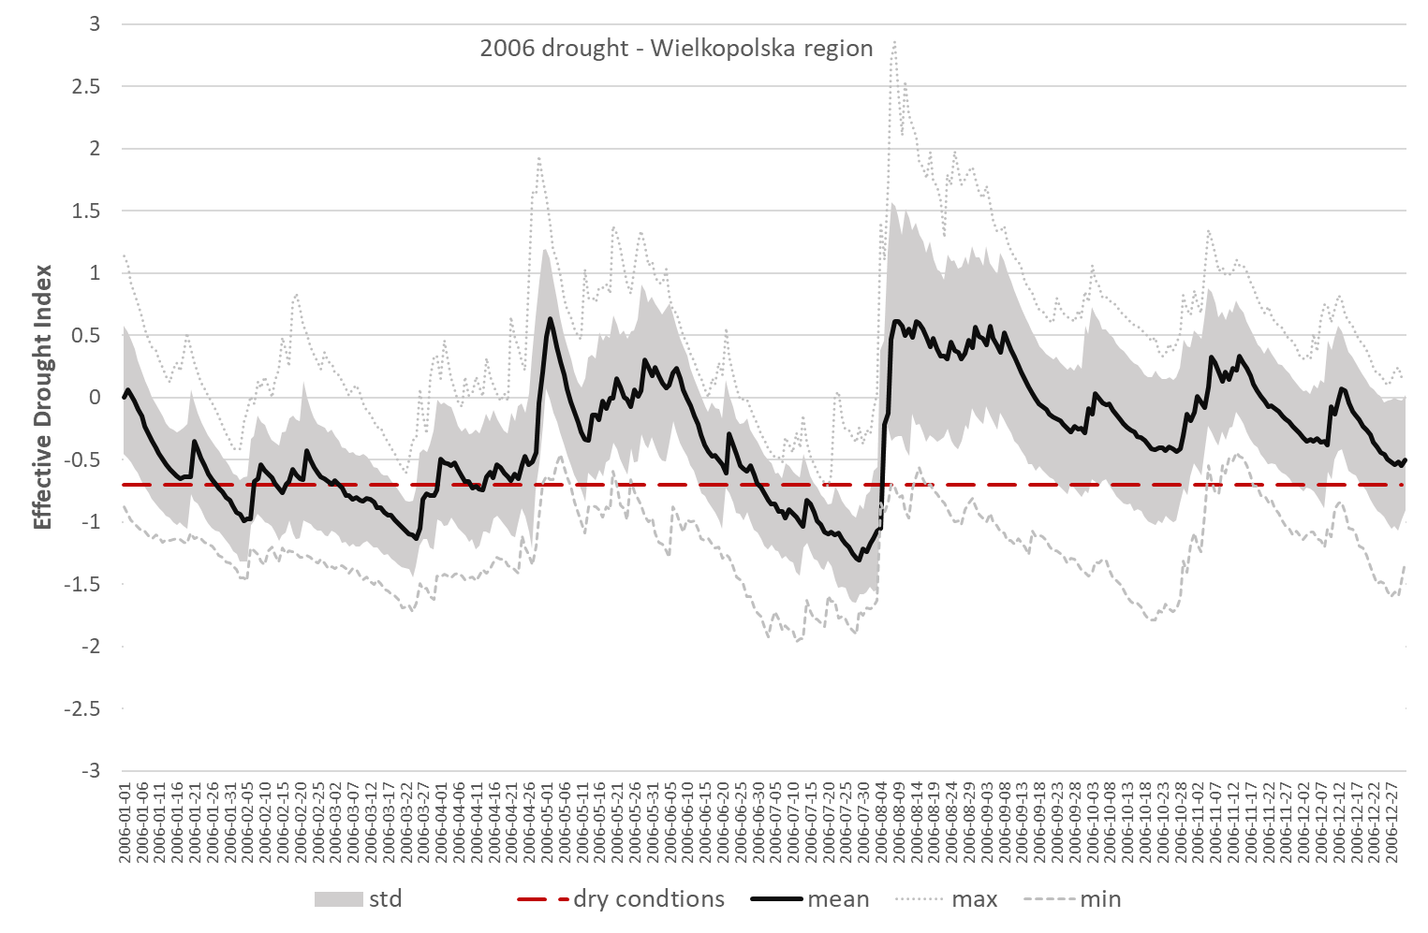
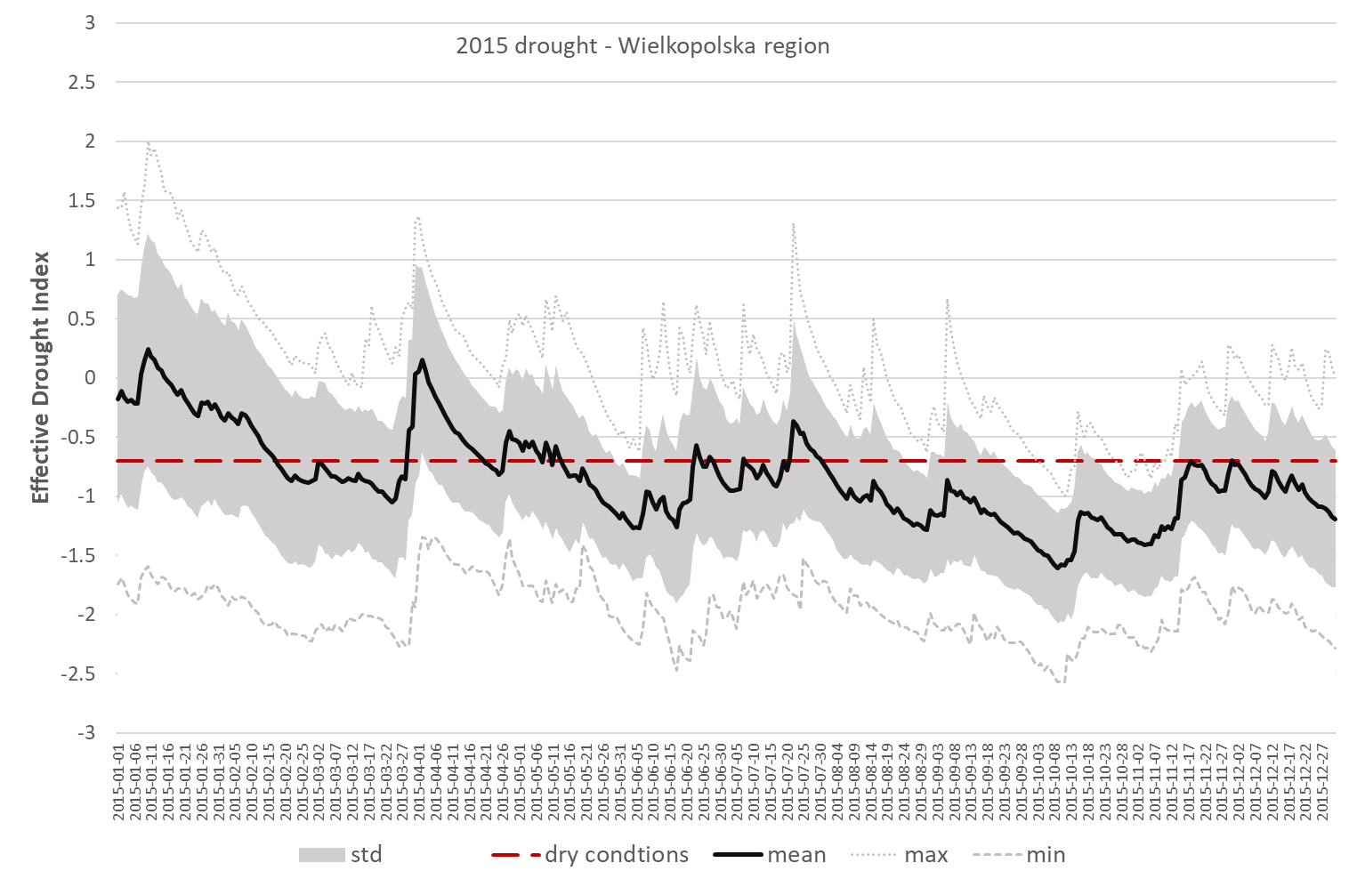
HAZARD INDICES
EDI (Effective Drought Index)

Slide 8
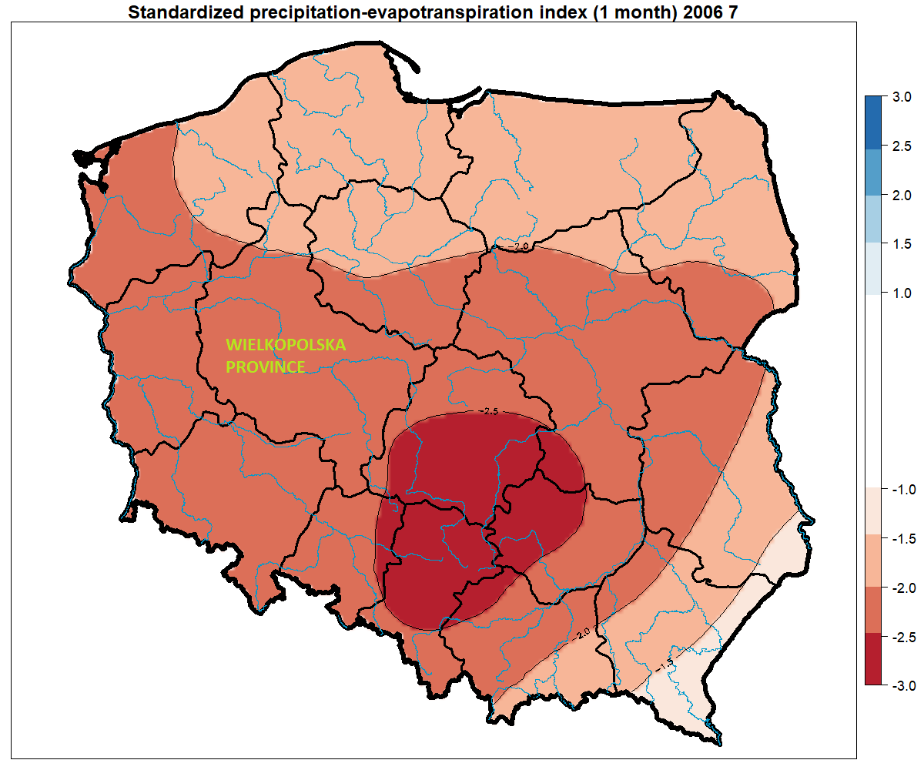
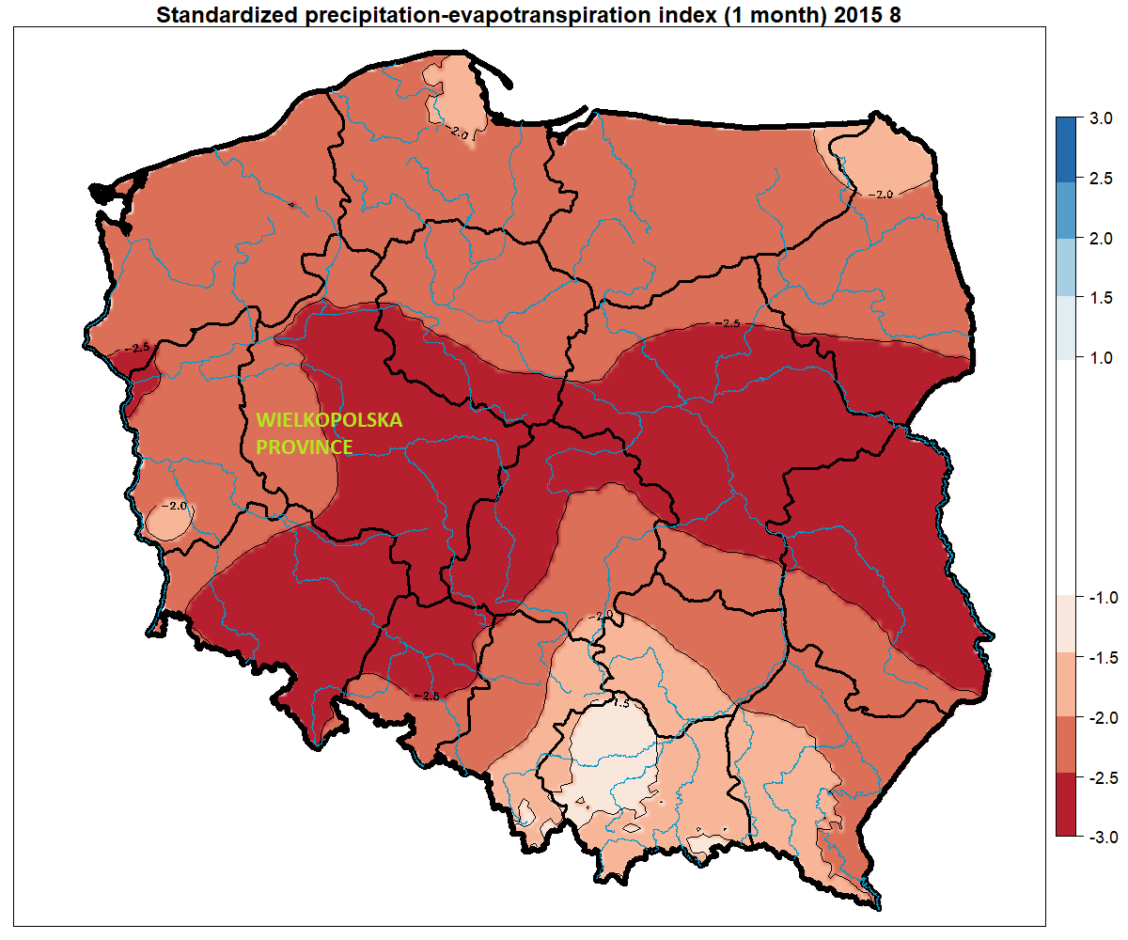
HAZARD INDICES
SPEI (Standardized Precipitation Evapotranspiration Index )

Slide 9
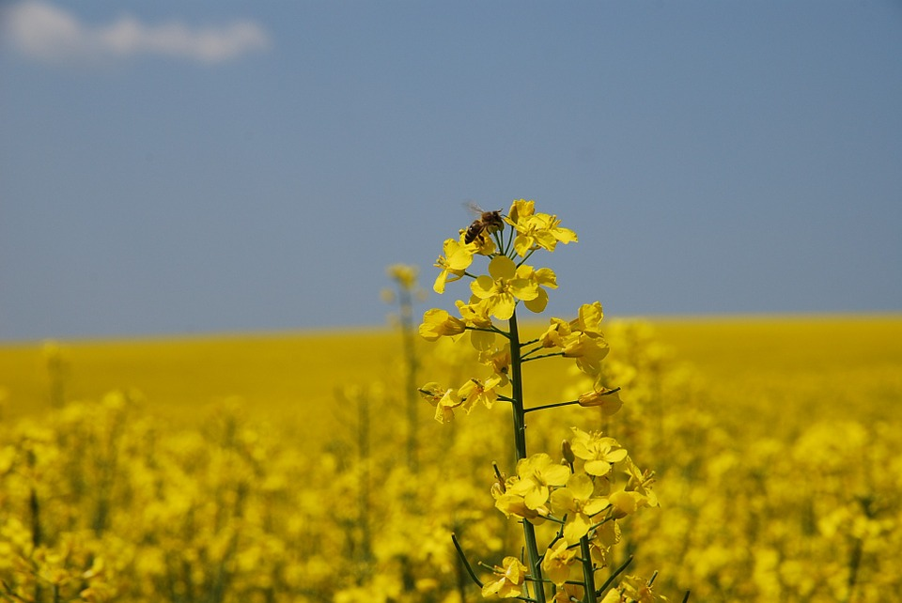

EXPOSURE INDICES
CROP MASK: WINTER RAPE
Crop recognition algorytm based on satellite images
Degree days – PHENOLOGICAL PHASES
germination
stem growth
Inflorescence formation
blooming
maturation

Slide 10
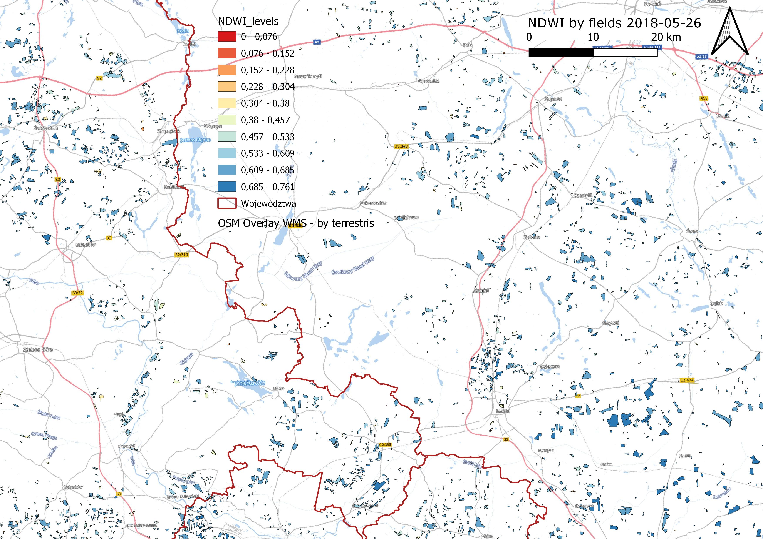
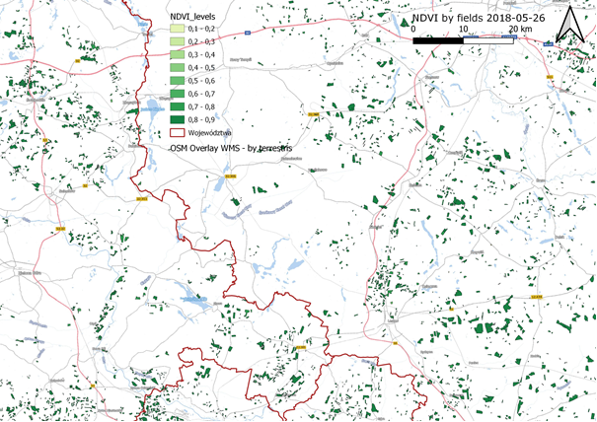
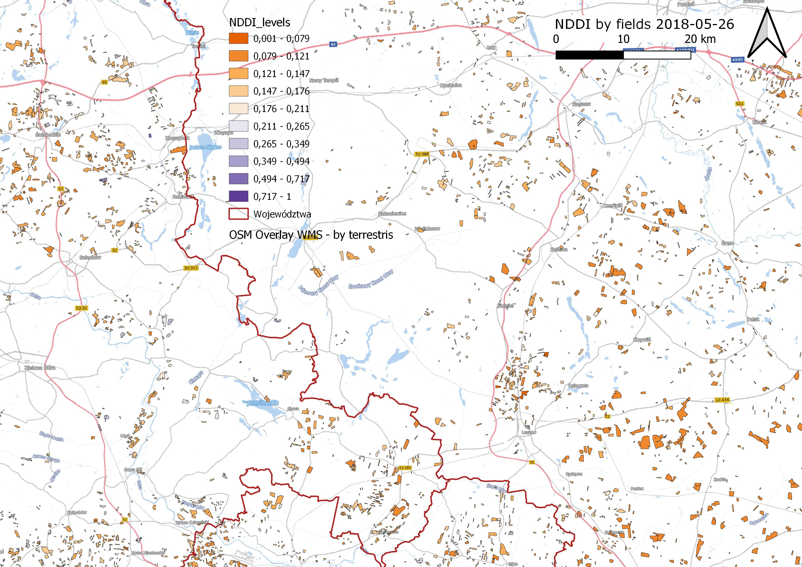
SENSITIVITY INDICES
SENTINEL 2
NDVI (NORMALIZED DIFFERENCE VEGETATION INDEX) shows the greenes, density and health of vegetation.
Values close to 1: the most intense the green, the most vigorous the vegetation and vegatation cover.
NDDI (NORMALIZED DIFFERENCE DROUGHT INDEX)combines information brom both the NDVI and NDWI
High values indicate an intense drought
NDWI (NORMALIZED DIFFERENCE WATER INDEX) is used to monitor crop water status, identify moisture deficyt and saturation in the crop.
High values correspond to high plant water content an coverage of a large part of plant.

Slide 11
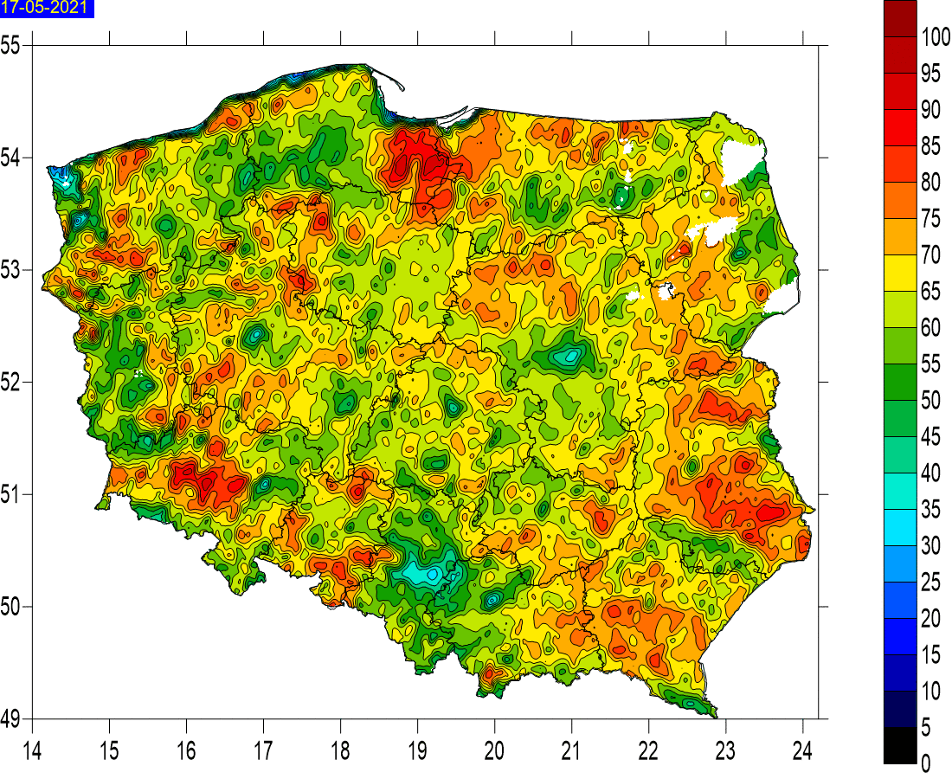
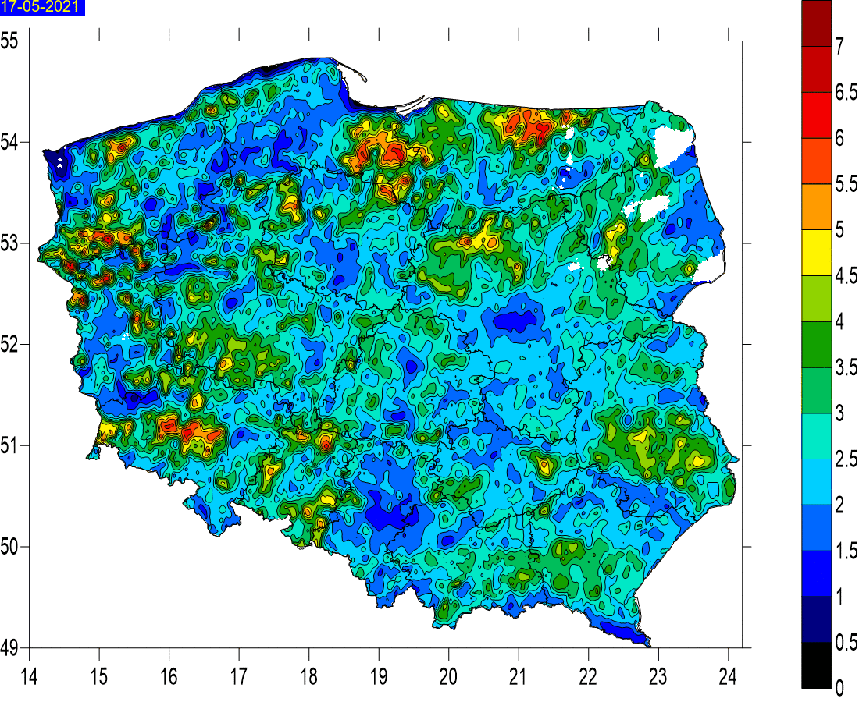
SENSITIVITY INDICES
LAI (LEAF AREA INDEX) quantifies the amount of lesf material in a canopy. It is a ratio of one-side leaf area per unit ground area.
For example a canopy with leaf area index of 3 would have a 3:1 ratio of leaf area to ground area.
In Poland LAI ranges from 1 to 7
fAPAR (fraction of absorber photosyntetically active radiation) quantifies the fraction of the solar radiation absorber by live leaves for the photosynthesis activity. Depends on the canopy structure, vegatation properties, atmospheric condition.

Slide 12
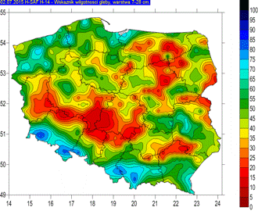
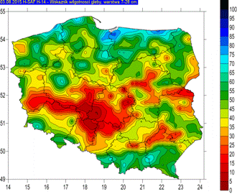
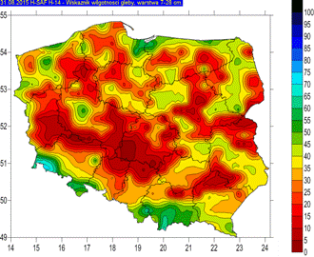
RESILIENCE INDICES
SMI (Soil Moisture Index) soil moisture profile index for four different soil layers (0-7, 7-28, 28-100 i 100-289 cm) generated based on the assimilation of ASCAT-derived surface soil moisture values to dedicated model. Results are function of soil type.
June 2015
July 2015
Aug 2015

Slide 13
RESILIENCE INDICES
SMI temporal variation for Świebodzinski powiat for 2 soil leyers:7-28 cm i 28-100 cm

Slide 14
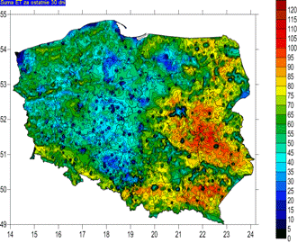
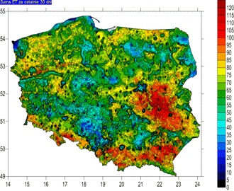
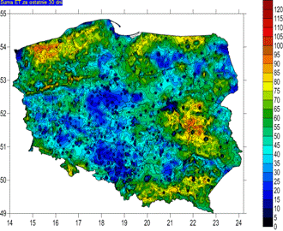
RESILIENCE INDICES
Actual evoptranspiration index product generated operationally with the use of ECMWF TESSEL SVAT modele with the use of combination of remote-sensed data and atmospheric model outputs LANDSAF
June 2015
July 2015
Aug 2015

Slide 15
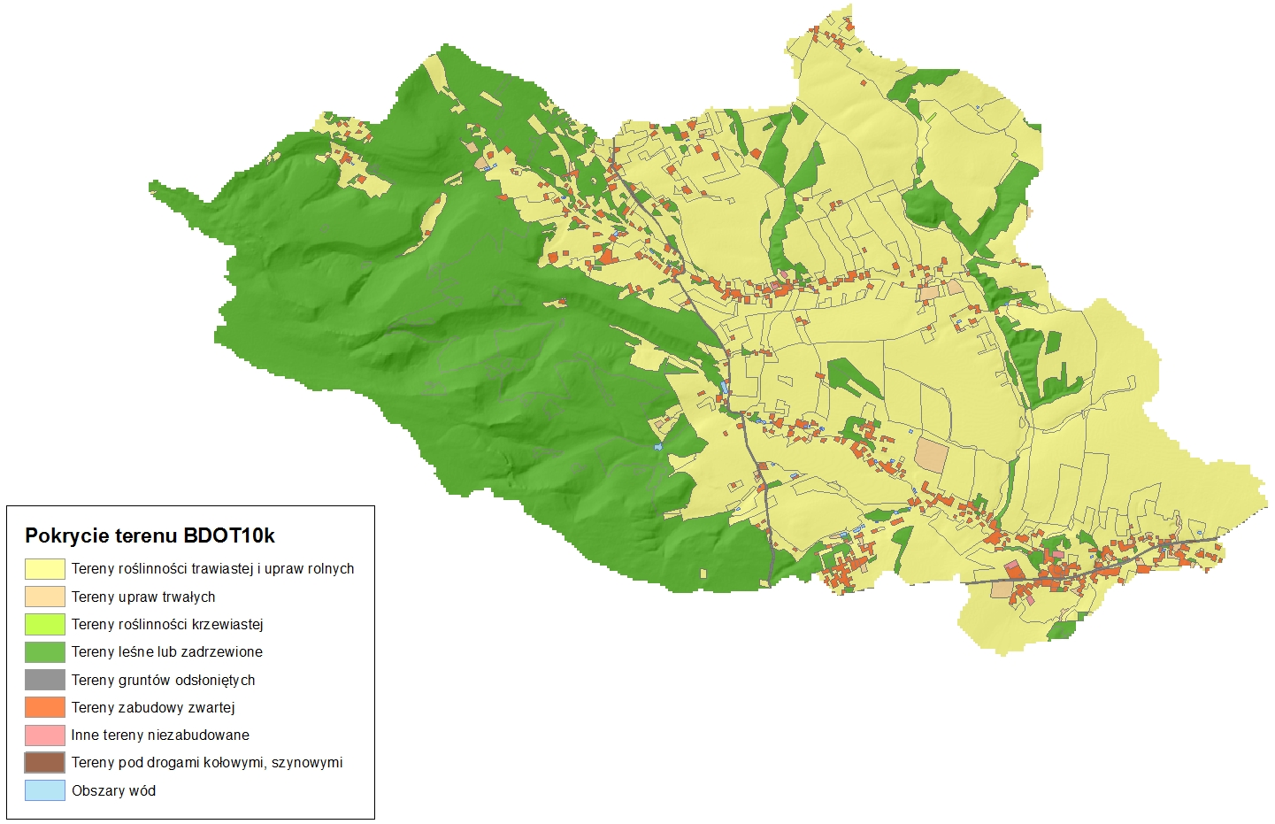
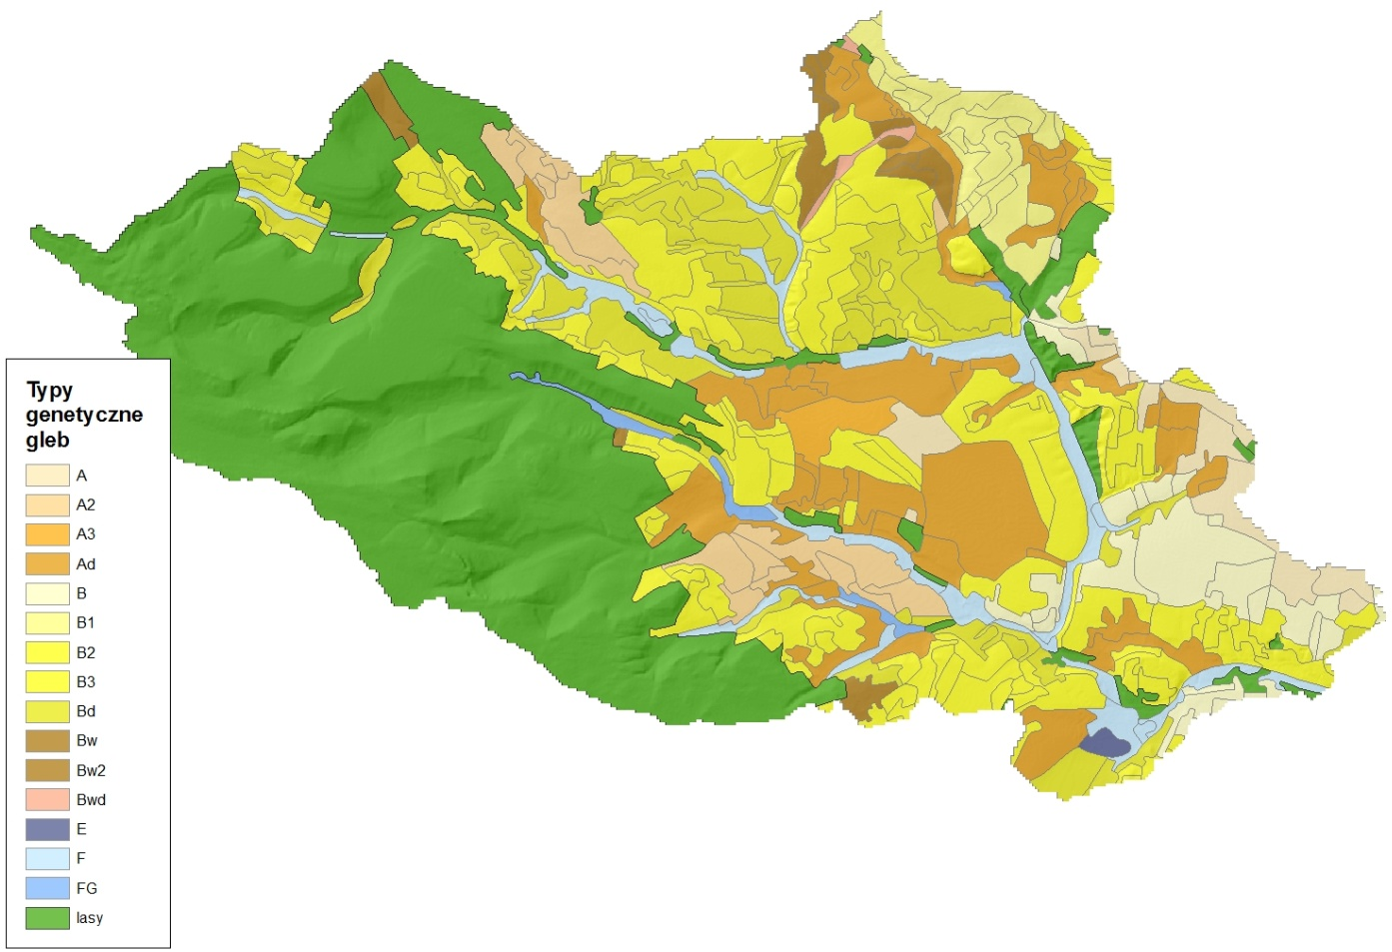
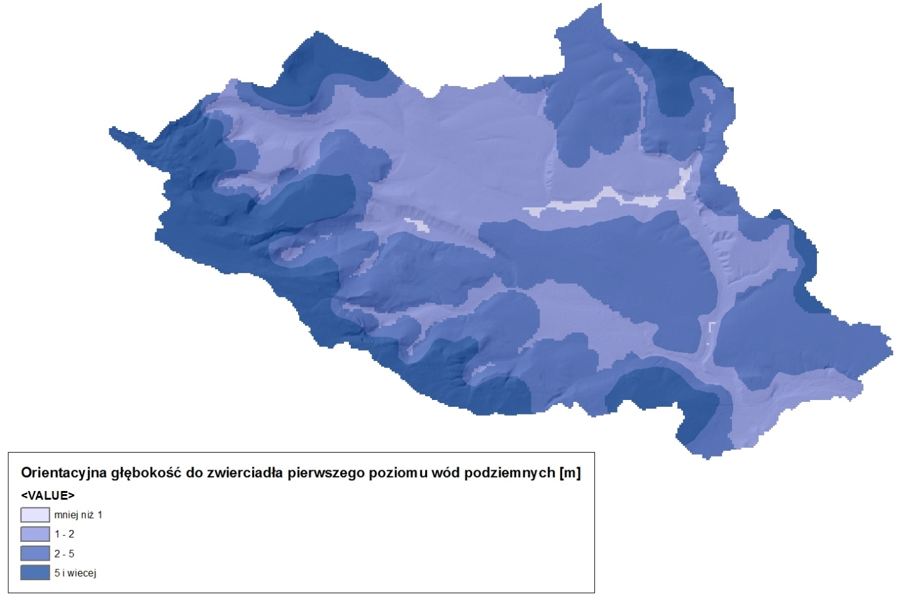
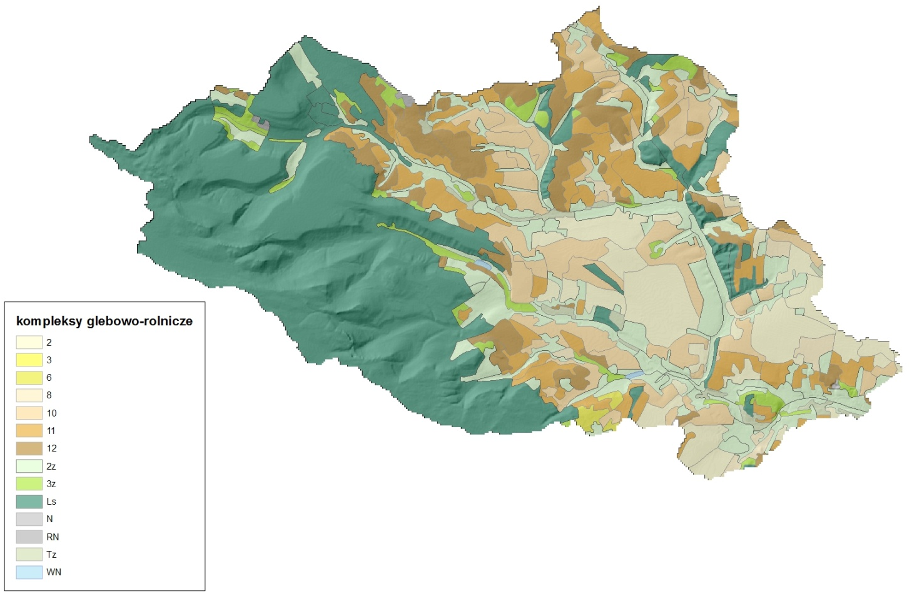
RESILIENCE INDICES
Distance to road
Soil classes
Groundwater levels
Soil-agricutural maps

Slide 16
RISK ASSESSMENT
Risk assessment:
Hazard
Exposure
Vulnerability :
Resilience (management/policy)
Consequences

Slide 17
RISK ASSESSMENT
HAZARD
 | 2006 | 2015
DURATION OF SOIL MOISTURE DROUGHT (name the (or more) respective indicator(s) the duration estimate is based on) | EDI mid Jun – end of July 1,5 months | EDI mid May – end of the year 7,5 months
level of evidence | robust | robust
SEVERITY OF SOIL MOISTURE DROUGHT (name the (or more) respective indicator(s) the severity estimate is based on) | SPEI extremely dry (SPEI <-2) | SPEI extremely dry (SPEI <-2)
level of evidence | robust | robust

Slide 18
RISK ASSESSMENT
EXPOSURE
NUMBER OF PEOPLE EXPOSED AND/OR AREA EXPOSED | sown area: 1488.2 thous. ha | sown area: 1463.5 thous. ha
level of evidence (limited, medium, or robust) | robust | robust
OBJECT CHARACTERISTICS (e.g. water users, crop types, building/household/company characteristics) | Basic cereals with cereal mixed: 1076.2 Potatoes: 54.5 Sugar beets: 50.4 Rape and agrimony: 83.7 | Basic cereals with cereal mixed: 900.7 Potatoes: 31.5 Sugar beets: 39.9 Rape and agrimony: 114.6
level of evidence | robust | robust
EXPOSURE HOTSPOTS (e.g. crop production hotspots, critical infrastructure / ecosystems, water exploitation index)

Slide 19
RISK ASSESSMENT
RESILINCE (MANAGEMENT/POLICY ASPECTS)
 | 2006 | 2015
WATER INFRASTRUCTURE (e.g. changes in irrigation management, irrigation infrastructure projects, deficits in irrigation infrastructure maintenance, preventing irreversible damage to infrastructure and ecosystems) | Usable capacity of water reservoirs in thous. m3: 57782 watered area of arable land: 11.4 thous. hectares | Usable capacity of water reservoirs in thous. m3: 53878 watered area of arable land: 10.4 thous. hectares
level of evidence (limited, medium, or robust) | robust | robust
DROUGHT RISK MANAGEMENT ASPECTS (e.g. risk assessment, water conservation measures, introduction/changes of early warning systems for droughts, risk communication campaigns, water awareness campaigns, recovery aspects) | Irrigation method: percent of irrigated area by: ascent method (92.8%) sprinkling machines (7%) | Irrigation method: percent of irrigated area by: ascent method (89.9%) sprinkling machines (9.8%)
level of evidence (limited, medium, or robust) | robust | robust
AWARENESS (e.g. drought perception, private precaution undertaken by e.g. farmers)
PREPAREDNESS (e.g. drought early warning systems, use of seasonal forecasts, precautionary measures, e.g. changing crop type)
CRISIS MANAGEMENT (e.g. water-use restrictions, public management organization, emergency plans, e.g. fallowing land)

Slide 20
RISK ASSESSMENT
CONSEQUENCES
Number of fatalities | Ratio of harvest to sown area in comparision to previous year: 22% reduction for basic cereals with cereal mixed 15% reduction for potatos 1% reduction for sugar beets 5% reduction for rape and agrimony | Ratio of harvest to sown area in comparision to previous year: 12% reduction for basic cereals with cereal mixed 27% reduction for potatos 25% reduction for sugar beets 12% reduction for rape and agrimony
level of evidence | robust | robust
Number of affected people | persons employed in agriculture: 205275 including public sector (3131) and private sector (202144) Population in rural areas: 1457000 | persons employed in agriculture: 209160 including public sector (1905) and private sector (207255) Population in rural areas:
level of evidence | robust | robust
DIRECT ECONOMIC IMPACTS (Monetary damage e.g. to agriculture)
INDIRECT IMPACTS (if particularly relevant)
INTANGIBLE IMPACTS (e.g. health/psychological aspects, damage to the environment, if particularly relevant)

Slide 21
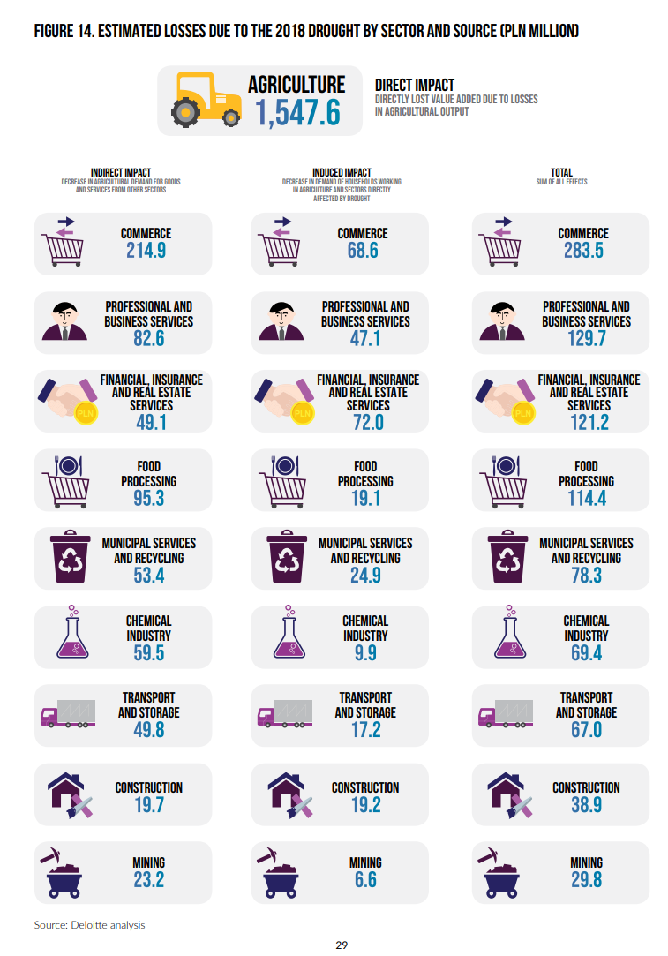
RISK ASSESSMENT
INDIRECT IMPACTS

Slide 22
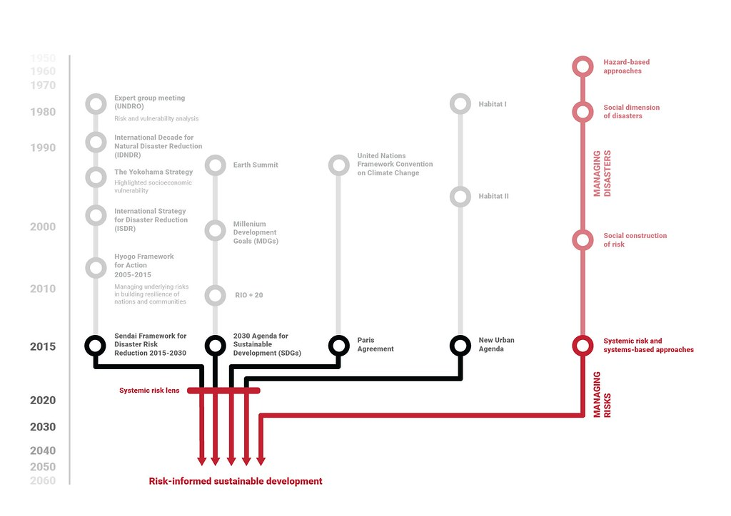
RISK REDUCTION
Risk reduction – a journey through time and space
Source: UNDRR 2019

Slide 23
RISK REDUCTION – constantly emerging issues
Uncertainties associated with climate change and its manifestation at all levels including cascading risks.
Understanding the increasingly complex pathways through which drought affects filter (e.g. the water–energy–food nexus, socioecological buffers and thresholds).
Assessing the costs of drought impacts, and the benefits of action and costs of inaction.
Enhancing the role of technology, efficiency and community-based knowledge.
Links to human security, globally networked risks and conflict that affect resilience.
Emphasizing the role of governance, financing and decision-making in anticipating, assessing and acting on reducing and managing the impacts of complex risks.
The need to explicitly acknowledge various social values and strengthening institutional mechanisms for collaboration, including data collection. How drought and climate change may play into future fragility will be an area of increasing research and security interest.

Slide 24

Thank you!

